Slide 1
Various Shapes, Stroke Weight, Fill()
Mack 2021

Slide 2
Overview
In this learning activity students will create a visual composition using various p5 shape-drawing functions. They will continue to build on their understanding of functions and their parameters to recreate the robot from lesson 1.

Slide 3
Objectives
Students will be able to:
Consult the p5 reference
Create triangles
Create quadrilaterals
Create arcs
Create shapes defined by their vertices
Use layering to create images

Slide 4
Intro
While it's great to place shapes on the canvas using built in functions, we're going to learn a shortcut in order to help us draw more complex shapes to make more interesting drawings. First, because this activity will have you problem solving, we must go over "what to do when feeling stuck":
Ask yourself:
What was supposed to happen?
What happened instead?
If there is an error message look at the line number and error description. If the error message has a suggestion try that first.
Check for common errors working line by line from top to bottom
Play with the code. Make one change at a time then hit run.
Use teamwork. Compare your code to the code of someone next to you.
Check out the p5.js online reference. www.p5js.org/reference

Slide 5
Change The Shade and Stroke of your Shapes
You might have noticed this: if you don't change anything, your shapes are drawn with a white fill, and a thin, black stroke. To change these, you can use the fill() and stroke() functions. When given one parameter, fill() is set to a shade of gray between 0 (black) and 255 (white). To get rid of the stroke add noStroke() and to get rid of the fill, add noFill(). You can also change the thickness of the stroke by adding strokeWeight(). Remember that since the code runs from the top down, when you change the fill or stroke, that change will apply to all of the code beneath it.

Slide 6
Change The Shade and Stroke of your Shapes
It can be useful to compare the program to a person drawing from instructions. You might instruct a person to:
Pick up a white pen
Draw a square
Switch to a gray pen
Draw an ellipse
Draw a line
The square would be white and both the ellipse and the line, as well as anything else you tell the person to draw, would be gray until you tell them to switch pens again. Since the code runs from the top down, it will work the same way. If you add a white fill, and draw three shapes beneath that line of code, all three shapes will be white.
Play with the thickness of the stroke and its shade of gray here.

Slide 7
Draw Other Shapes and Navigate the p5.js Reference
Use the p5 reference to complete this worksheet and then create the following shapes in the p5.js editor:
Triangle using triangle() function
Quadrilateral using quad() function
Star using beginShape() function
Arc.
Your sketch should include:
A canvas size of 600 pixels wide by 120 pixels high.
Light gray background.

Slide 8
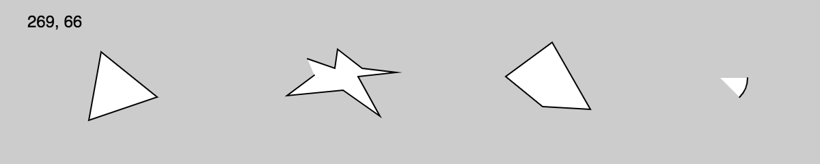
Examples of possible outputs

Slide 9
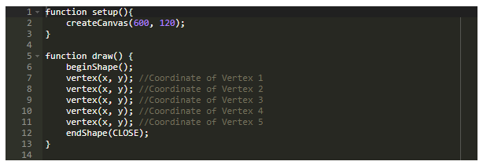
Draw Other Shapes and Navigate the p5.js Reference
To draw a polygon, first call the beginShape() function, then call the vertex(x, y) for each vertex of the polygon. End the shape with endShape(CLOSE).

Slide 10
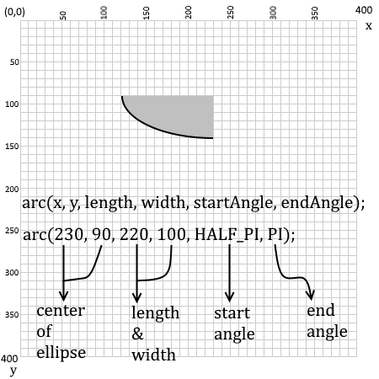
Arcs
If you're up for a challenge, check out the p5.js reference to make arcs and curves.
Arcs are part of ellipses (or circles). To draw an arc, we need to specify the start angle and end angle of the portion of the ellipse that we want to draw.

Slide 11
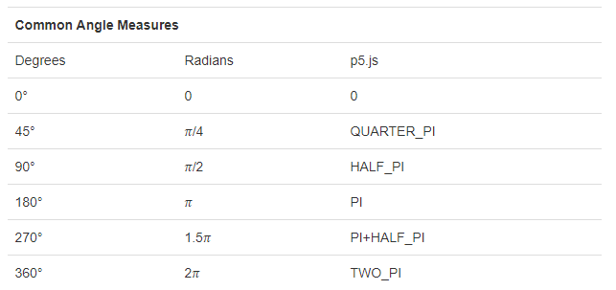
Arcs
In p5js, angles are specified not in degrees but a unit called RADIANS. Angles are also measured in the CLOCKWISE direction.

Slide 12
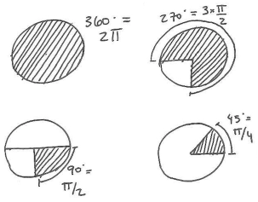

Arcs
If you would rather work with degrees and not radians (90 instead of PI/2), add this line to your code: `angleMode(DEGREES).` Use this p5 reference cheat sheet to learn more and recreate the following: Possible Solution

